Slide 1
AHB2APB Bridge Verification
Prajwal
RN-112

Slide 2
content
Introduction
TB Architecture
Verification Plan
Block diagram
AHB
AHB Waveforms
APB
APB Waveforms
Project Objective
Conclusion

Slide 3
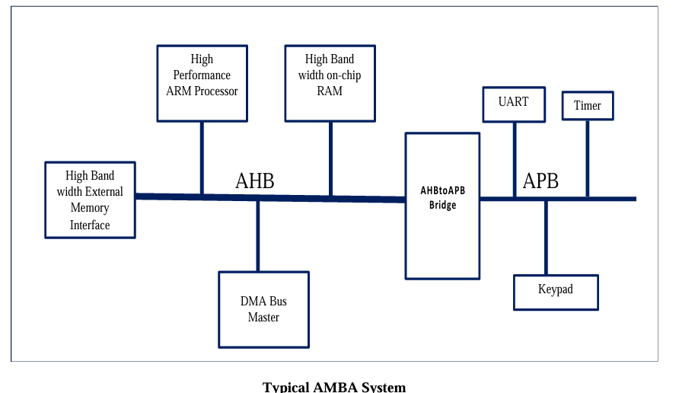
introduction
AMBA(Advanced Microcontroller Bus Architecture) was introduced by ARM in 1996, as interface for their microprocessor
AMBA 2.0 released in 1999, includes APB and AHB. AMBA 3.0 released in 2003 includes AXI.
In an ARM-based system, a bridge is often used to interface between the high-speed AHB (Advanced High-performance Bus) and the slower APB (Advanced Peripheral Bus) to ensure efficient communication between the processor and peripheral devices.
The AHB side acts as a Master and the APB side acts as a Slave. The AHB to APB Bridge is the Slave for the AHB and the Master for APB side

Slide 4
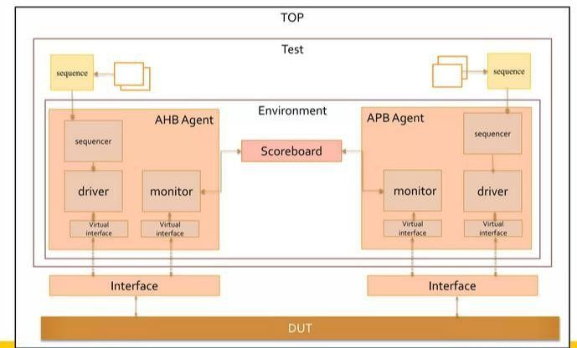
Tb architecture

Slide 5
Verification plan
Strategies:
1. Reset
Write zeros into the memory to ensure a clean start.
2. Read
Random Read: Read valid data from memory.
SB (Scoreboard) Check: Compare the data only during read operations.
Receiver: Collect read addresses and data_out to create transactions.
Random Read (Empty Location): Verify behavior when reading from an uninitialized memory location.
SB Message: Ensure that no random data is written when reading from empty locations.
Random Read (Consecutive Locations): Read the same memory locations multiple times to verify consistency.
3. Write
Random Write: Write to random memory locations.
Consecutive Write: Write into the same memory locations consecutively and verify data integrity.
Random Read/Write Transactions: Send randomized read/write requests from AHB to APB and verify correctness.
Burst Transactions: Perform sequential and non-sequential burst transactions from AHB and validate corresponding APB responses.

Slide 6
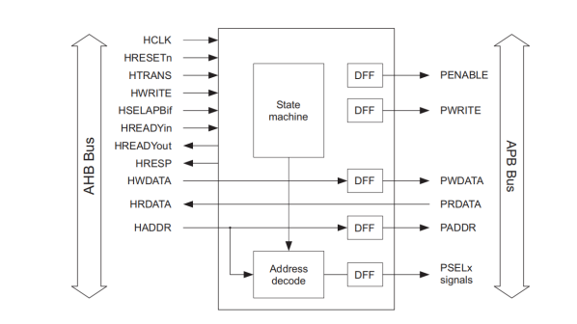
Block diagram

Slide 7
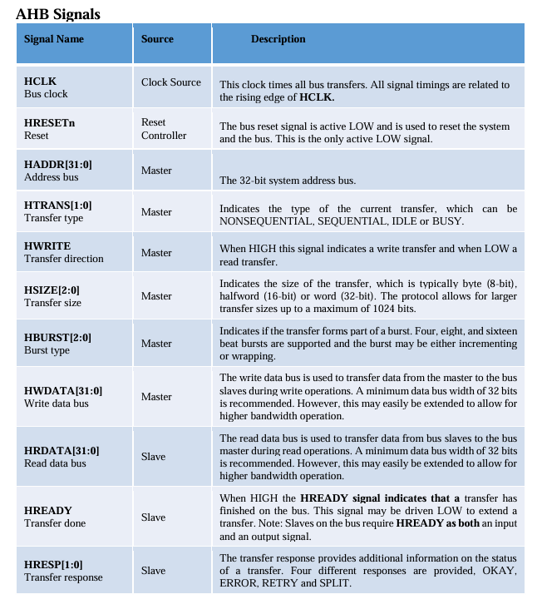
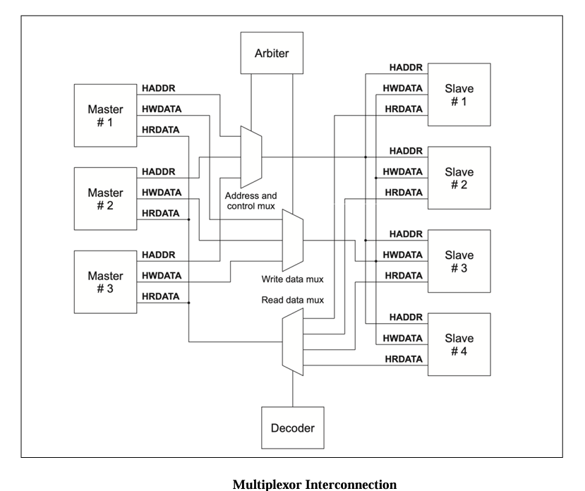
AHB AMBA AHB is for high performance, higher clock frequency system module .

Slide 8
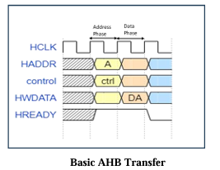
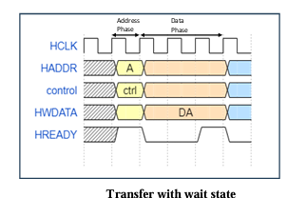
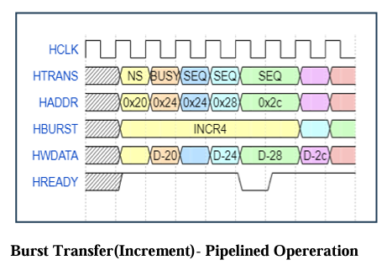
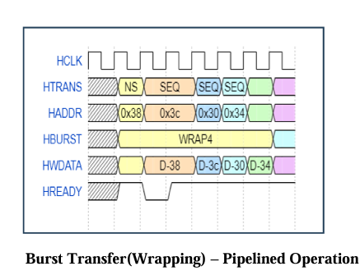
Ahb waveforms

Slide 9
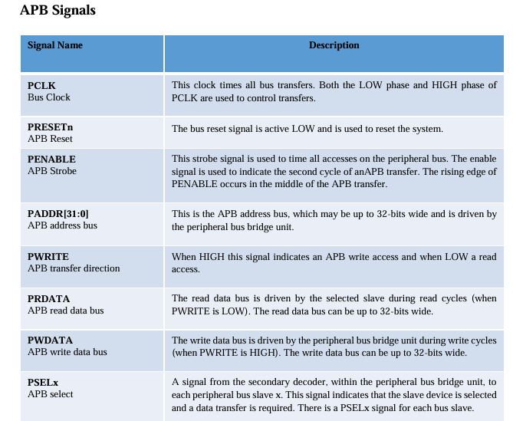
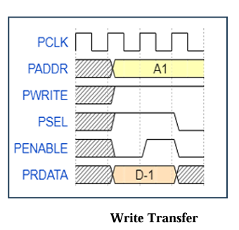
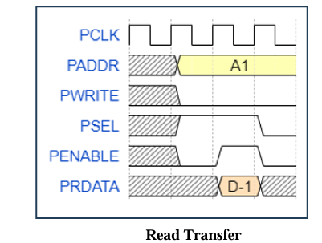
ApB AMBA APB is for low –power peripherals, it is optimized for minimal power consumption and reduced interface complexity to support peripheral function.

Slide 10
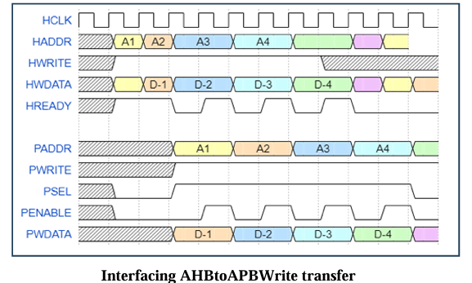
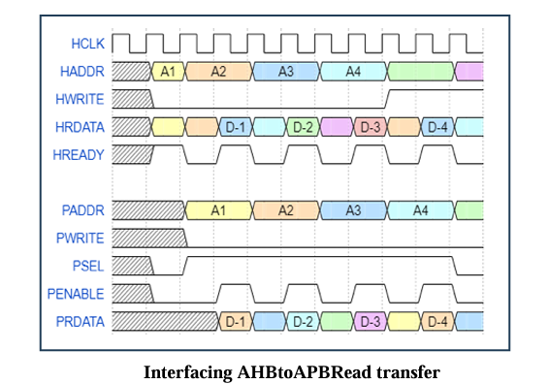
Apb Waveforms

Slide 11
Project Objective
Main Goal: Verification of an efficient AHB to APB bridge ensuring seamless communication between the two bus protocols
Expected Outcomes: Achieve successful data transfers between AHB and APB with minimal latency and comprehensive verification coverage.
How Objectives Were Met: Developed a structured verification plan including functional, performance, and corner-case testing.

Slide 12
Conclusion
The AHB to APB bridge project successfully demonstrated the efficient communication between high-speed and low-speed components in ARM-based systems. By using the bridge, the project effectively connected the high-performance AHB (Advanced High-performance Bus) to the slower APB (Advanced Peripheral Bus), ensuring that the processor could efficiently manage both memory and peripheral devices.
The project also highlighted the importance of having a well-designed interface to handle different bus speeds, enabling seamless integration between high-speed processing and slower peripheral tasks.

Slide 13
Thank You

